Slide 1
Static and Dynamic Analysis
Christopher Parnin

Slide 2
Esprima for Static and Dynamic Analysis
https://www.youtube.com/watch?v=ACYZFkvq0Sk
Watching 5:00-14:30, 28:00-34:00

Slide 3
Bad Smells
Duplicated Code
bad because you modify one instance of duplicated code but not the others; not all versions fixed
Long Method
long methods are more difficult to understand; performance concerns with respect to lots of short methods are largely obsolete
Message Chains
a client asks an object for another object and then asks that object for another object etc.
Bad because client depends on the structure of the navigation

Slide 4
More Smells
Primitive Obsession
Long Parameter List
Data Clumps
Temporary Field
Refused Bequest
Divergent Change
Shotgun Surgery
Speculative Generality
Feature Envy

Slide 5
Static Analysis Tools
Coverity (http://cacm.acm.org/magazines/2010/2/69354-a-few-billion-lines-of-code-later/fulltext)
FindBugs, FxCop, PyLint, JsLint, CheckStyle
Parse Tools: Roslyn (.NET), Esprima, Eclipse JDT (Have headless parser)

Slide 6
Activity
Describe some other “bad smells” or properties you would detect?

Slide 7
Data Flow Analysis
A framework for proving facts about a program.
Examines how information propagates through blocks and paths of a program.
Content: http://www.seas.harvard.edu/courses/cs252/2011sp/slides/Lec02-Dataflow.pdf,
https://www.cs.umd.edu/class/spring2014/cmsc430/lectures/lec19.pdf

Slide 8
Reaching Definitions
A definition of a variable x is a statement that may modify the value of x.
A use of a variable x is a statement that reads from x.
A definition at node k reaches node n if there is a definition-free path from k to n.

Slide 9
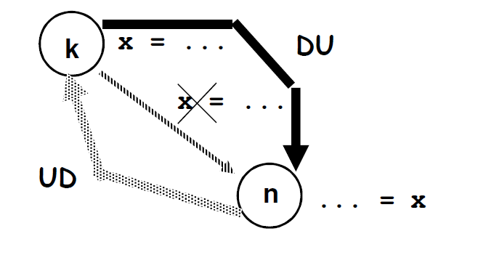
Def-Use/Use-Def Chains
DU-Chain: Links each def to uses it reaches
UD-Chain: Links each use to reaching defs
foo(b) {
x = 1;
if( b < 0 )
{
x = 2;
}
b = x;
}

Slide 10
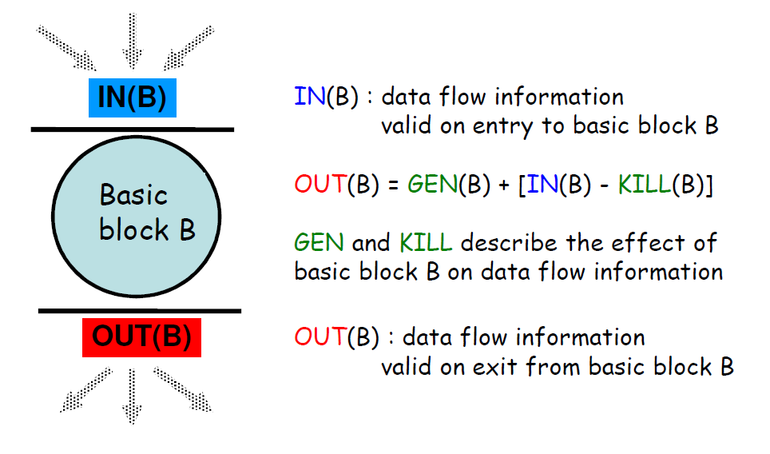

Slide 11
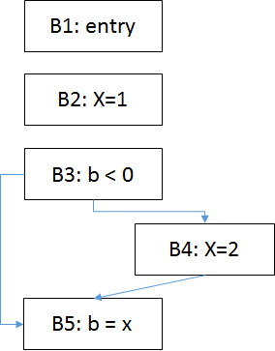
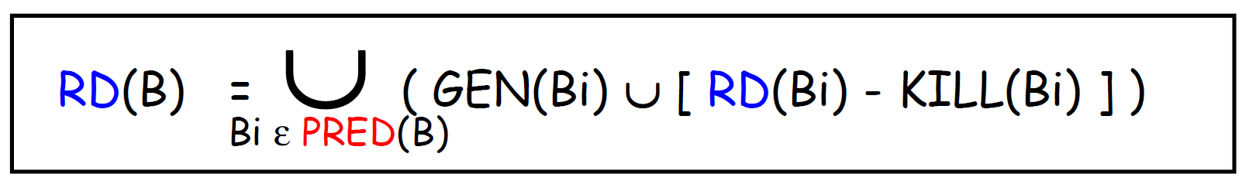
 | Gen | Kill | Flow | RD
B1 | entry(B) | B | entry(B) U ( ∅ - B ) | entry(B)
B2 | B2(X) | X | B2(X) U ( entry(B) - X ) | B2(X), entry(B)
B3 |  |  | ∅ U ({B2(X),entry(B)} - ∅ ) | B2(X), entry(B)
B4 | B4(X) | X | B4(X) U ({B2(X),entry(B)} - X) | B4(X), entry(B)
B5 | B5(B) | B | B5(B) U {B2(X),B4(X),entry(B) - B} | B2(X), B4(X), B5(B),

Slide 12
Worklist Algorithm
OUT[ENTRY] = empty_set;
for (each block B other than ENTRY)
OUT[B] = empty_set;
while (changes to any OUT occur)
for (each block B other than ENTRY)
{
IN[B] = ∪P a predecessor of B OUT[P]; OUT[B] = genB ∪ (IN[B] ─ killB);
}

Slide 13
Dynamic Analysis
Coverage… using instrumentation… probes
Important later for testing...performance...
Other Techniques:
Slicing
Performance, Memory Load
Taint Analysis
Random Testing

Slide 14
Random Testing
Activity: Why not just randomly generated input and see what happens?

Slide 15
Fuzzing
A technique for guiding random inputs
http://cosmolearning.org/video-lectures/how-i-learned-to-stop-fuzzing-and-find-more-bugs-with-jacob-w-manager/
http://research.microsoft.com/en-us/um/people/pg/public_psfiles/talk-issta2010.pdf

Slide 16
Applying Analysis to Deployment
Discuss how you might apply any of these techniques as a “Quality Gate” in a deployment pipeline.

Slide 17
Static Analysis
https://github.ncsu.edu/CSC510-Fall2014/Analysis
esprima video...
Common Properties
Cyclomatic Complexity, Coupling, Nested Depth
Bad Smells
Find Bugs, etc...

